Slide 1
The Evolution of Business Logic:
Mapping Rapid Development
Adrian Cockcroft
AWS VP Cloud Architecture Strategy
@adrianco

Slide 2

OLD WORLD IT
Marketing analytics
Employees at work
Sales channels
Factories + supply chain

Slide 3

NEW WORLD IT
OLD WORLD IT
Marketing analytics
Employees at work
Sales channels
Factories + supply chain

Slide 4



Mobile employees
NEW WORLD IT
Employees at work
Online marketing
Social media
Continuous supply tracking
Factories + supply chain
Online sales + delivery
Just in time production
IoT connected things

Slide 5
Personalization
Customer analytics
New channels direct to customer
More things, more scale, rapid change
New Needs
Notes:
Education example
New World: Product is interactive online content, customer is end user. Result is a personal learning plan. Engagement and retention
New Needs: Personalization, customer tracking, new channels direct to consumer by passing existing institutions

Slide 6

Evolution of Business Logic
Monolith
Microservices
Functions

Slide 7
Splitting Monoliths
Ten
Years Ago

Slide 8


XML & SOAP
Splitting Monoliths
Ten
Years Ago

Slide 9
Splitting Monoliths
Five
Ten
Years Ago

Slide 10
REST JSON
Fast binary encodings
Splitting Monoliths
Five
Years Ago

Slide 11
Splitting Monoliths
Five
Ten
Years Ago

Slide 13


Slide 15
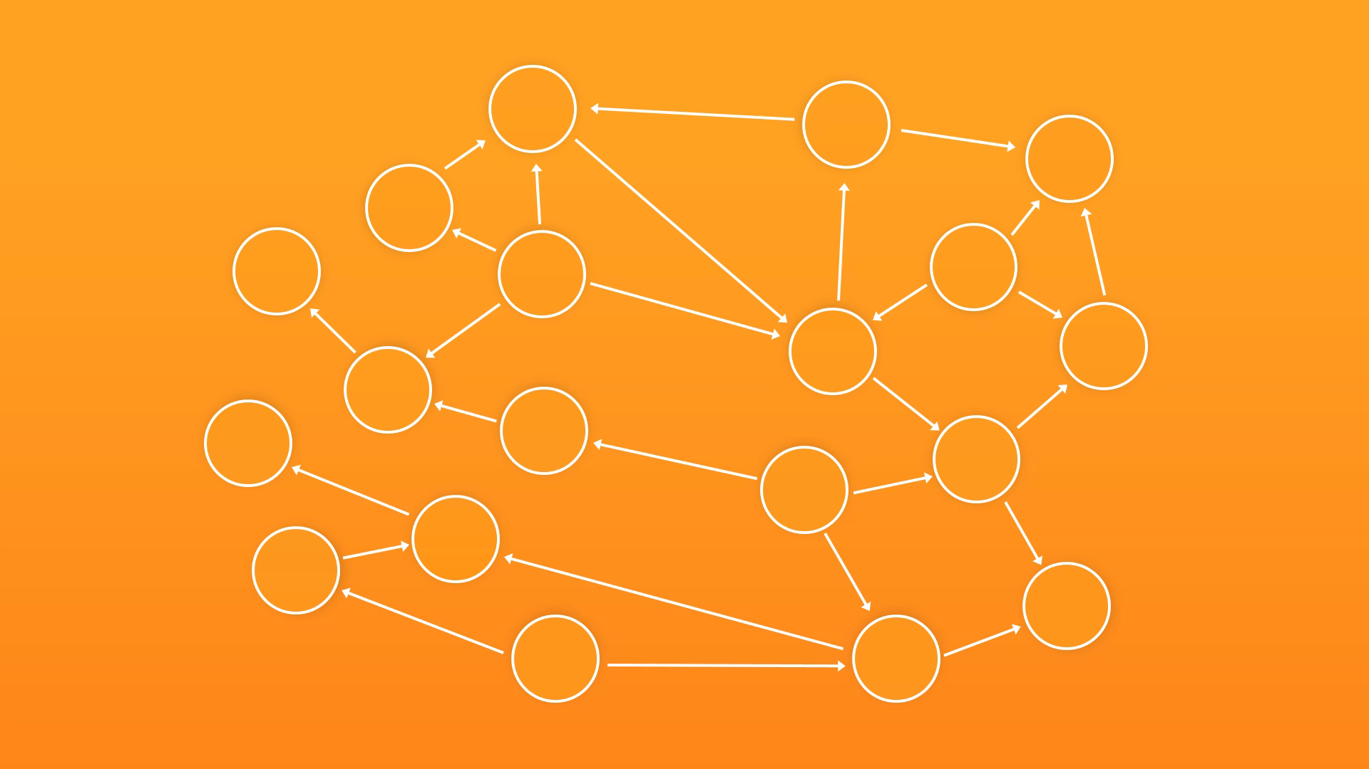
Microservices Five Years Ago

Slide 16
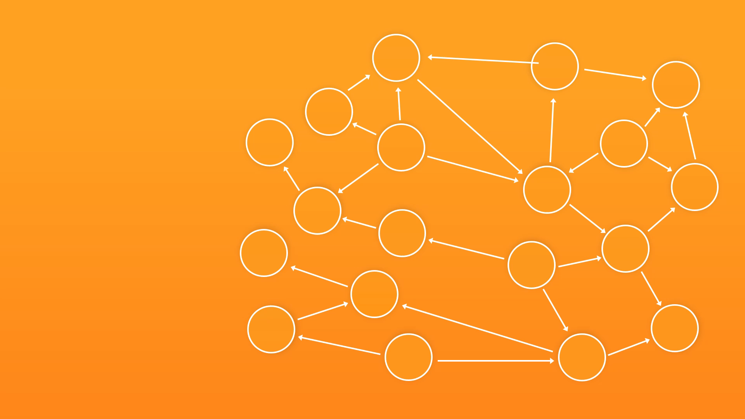

Slide 17






Amazon SQS
Microservices
Amazon API Gateway
Amazon DynamoDB
to Functions
Five Years Ago
Standard building brick services provide standardized platform capabilities
Amazon Kinesis
Amazon S3
Amazon SNS

Slide 18
Amazon SQS
Business Logic
Glue between the bricks
Microservices
Amazon API Gateway
Amazon DynamoDB
to Functions
Standard building brick services provide standardized platform capabilities
Amazon Kinesis
Amazon S3
Amazon SNS

Slide 19
Amazon SQS
Microservices
Amazon API Gateway
Amazon DynamoDB
to Functions
Amazon Kinesis
Amazon S3
Amazon SNS

Slide 20
Amazon SQS
Microservices
Amazon API Gateway
Amazon DynamoDB
to Functions
Amazon Kinesis
Amazon S3
Amazon SNS

Slide 21
Amazon SQS
Microservices
Amazon API Gateway
Amazon DynamoDB
to
Functions
Ephemeral
Amazon Kinesis
Amazon S3
Amazon SNS

Slide 22
Microservices
to
Ephemeral
Functions

Slide 23
Amazon SQS
Microservices
Amazon API Gateway
to
Ephemeral
Functions

Slide 24
Microservices
Amazon API Gateway
Amazon DynamoDB
to
Ephemeral
Functions
Amazon Kinesis

Slide 25
Microservices
Amazon API Gateway
to
Ephemeral
Functions
Amazon S3
Amazon SNS

Slide 26
Amazon SQS
Microservices
Amazon API Gateway
When the system is idle, it shuts down and costs nothing to run
Amazon DynamoDB
to
Ephemeral
Functions
Amazon Kinesis
Amazon S3
Amazon SNS

Slide 27
Evolution of Business Logic
Monolith
Microservices
Functions

Slide 28
Technology evolves, and our tech-stack choices need to be discussed, justified and decided.
Start with a few helpful questions…

Slide 29
What problem are you trying to solve?
HINT—Building or installing a framework is the wrong answer…
Something involving new user or business needs is a good answer:
Faster feature delivery?
International launch?
Lower cost?
Improved QoS?

Slide 30
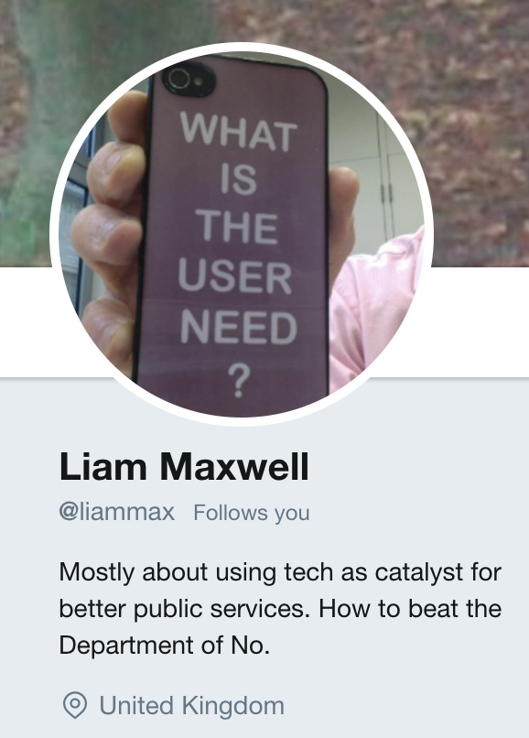
What is the user need?
What problem are you trying to solve?
—
User need

Slide 31

User need
What is the user need?
What does the value chain look like?
What’s your time-to-value?
How is the value chain evolving?
Have you heard of Simon Wardley?

Slide 32
Leverage
Wardley Maps
Visualize evolution and innovate further up the value chain
Notes:
New Needs: IoT, analytics, social media monitoring, scale with number of interactions times number of products shipped, predictive modeling

Slide 33
Let’s look at your
Wardley Map
What’s your position and movement on the map?
Notes:
New Needs: IoT, analytics, social media monitoring, scale with number of interactions times number of products shipped, predictive modeling

Slide 34
A Specific Example:
Travel Search

Slide 35
What problem are you trying to solve?
Users want:
Faster personalized search
Business wants:
Faster feature releases
Lower costs

Slide 36
User need
What is the user need?
What does the value chain look like?
Search Interface
Travel Datastore
Compute and Storage

Slide 37
Example created using
wardleymaps.com

Slide 38
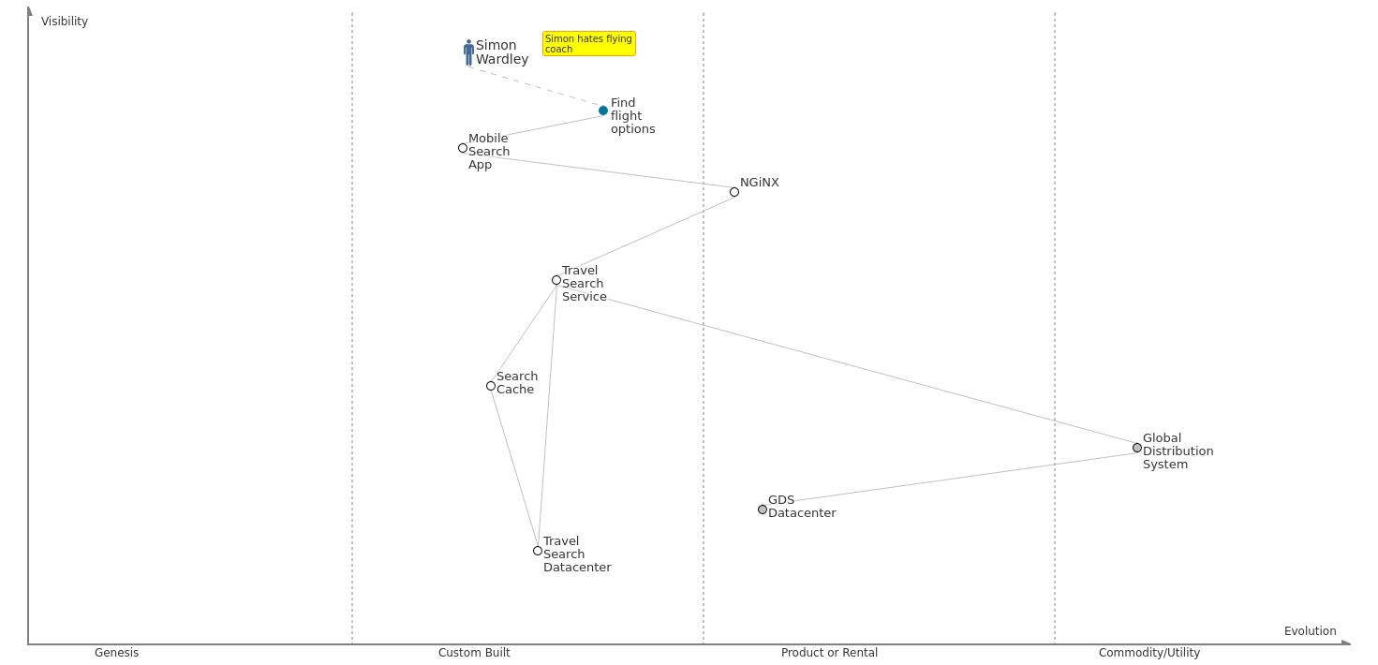
Travel search – starting point
Notes:
New Needs: IoT, analytics, social media monitoring, scale with number of interactions times number of products shipped, predictive modeling

Slide 39
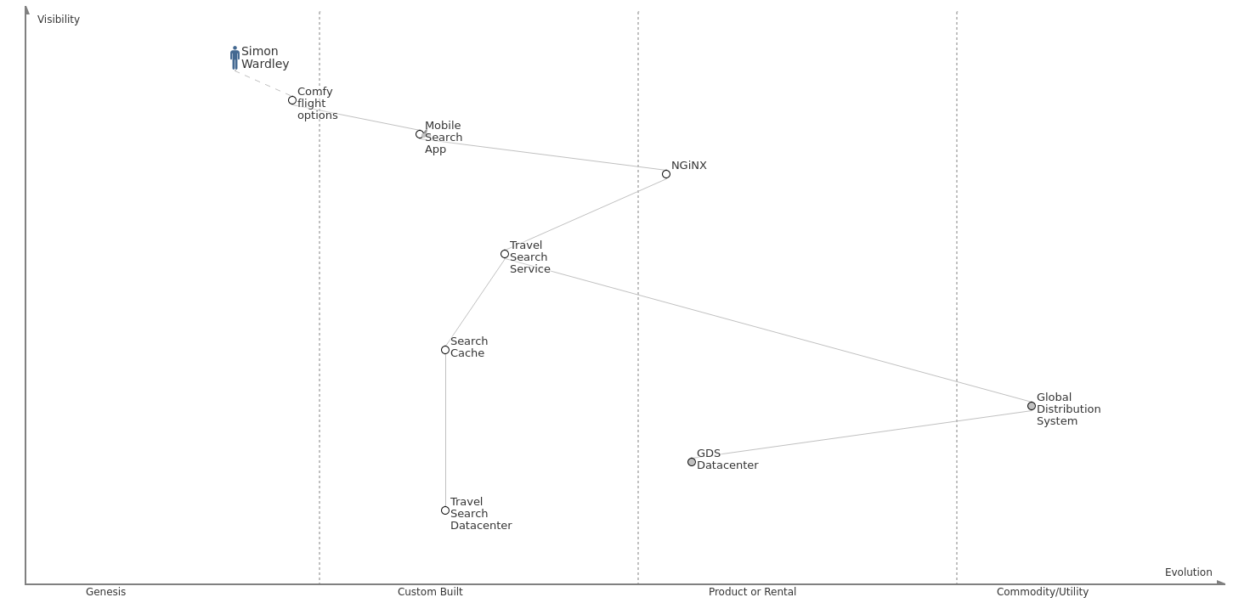
User need – comfy seat search
Notes:
New Needs: IoT, analytics, social media monitoring, scale with number of interactions times number of products shipped, predictive modeling

Slide 40
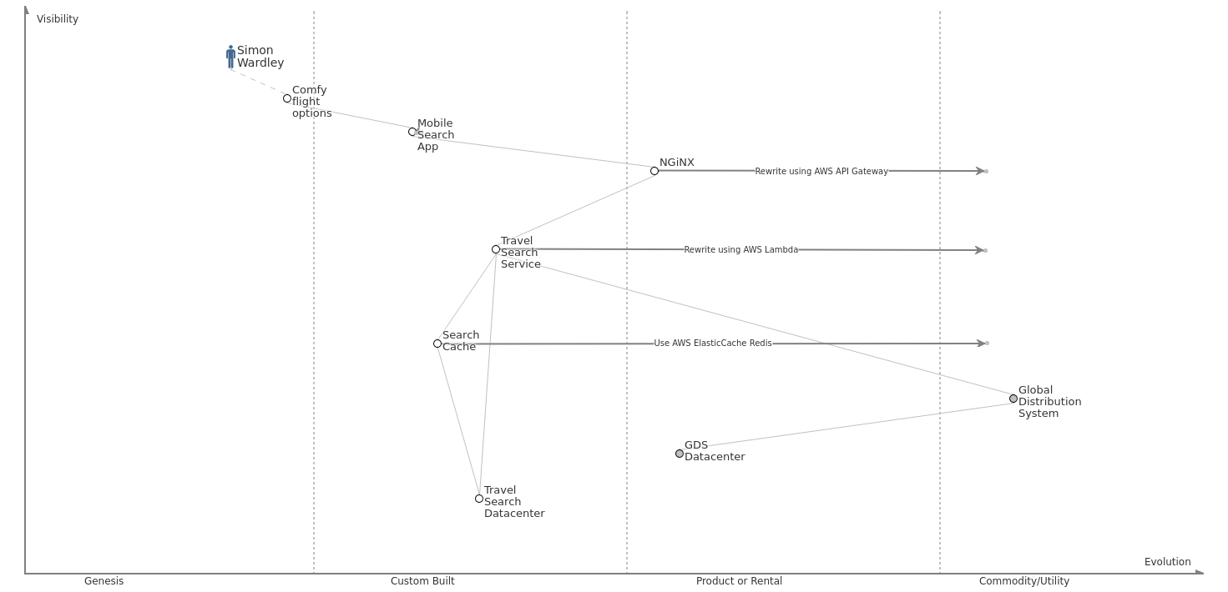
Business goal – reduce search cost
Notes:
New Needs: IoT, analytics, social media monitoring, scale with number of interactions times number of products shipped, predictive modeling

Slide 41
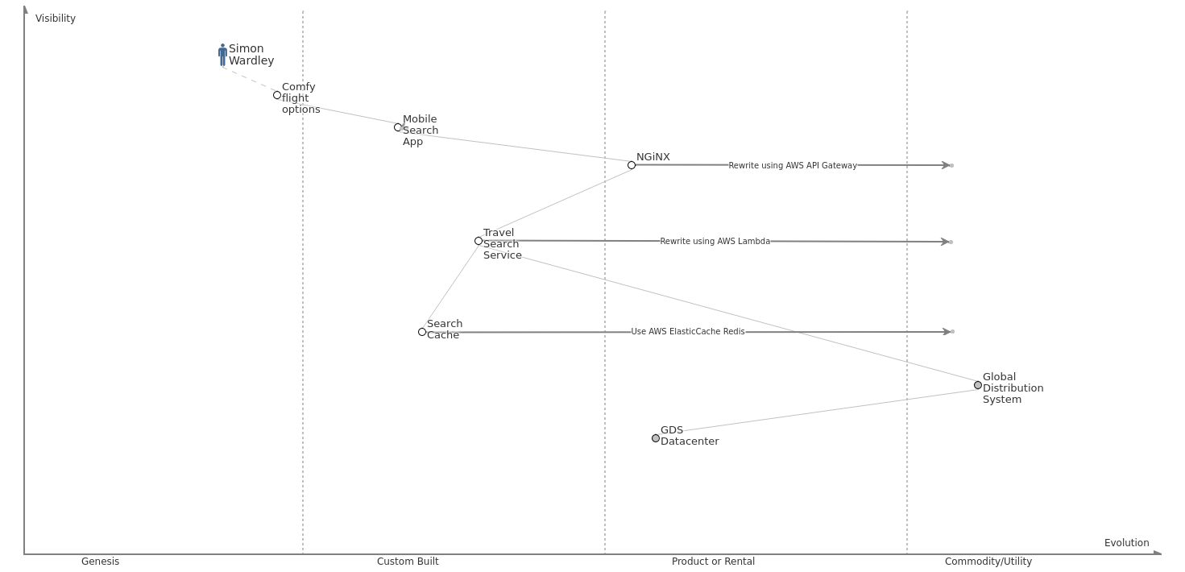
Stack evolution – exit datacenter
Notes:
New Needs: IoT, analytics, social media monitoring, scale with number of interactions times number of products shipped, predictive modeling

Slide 42
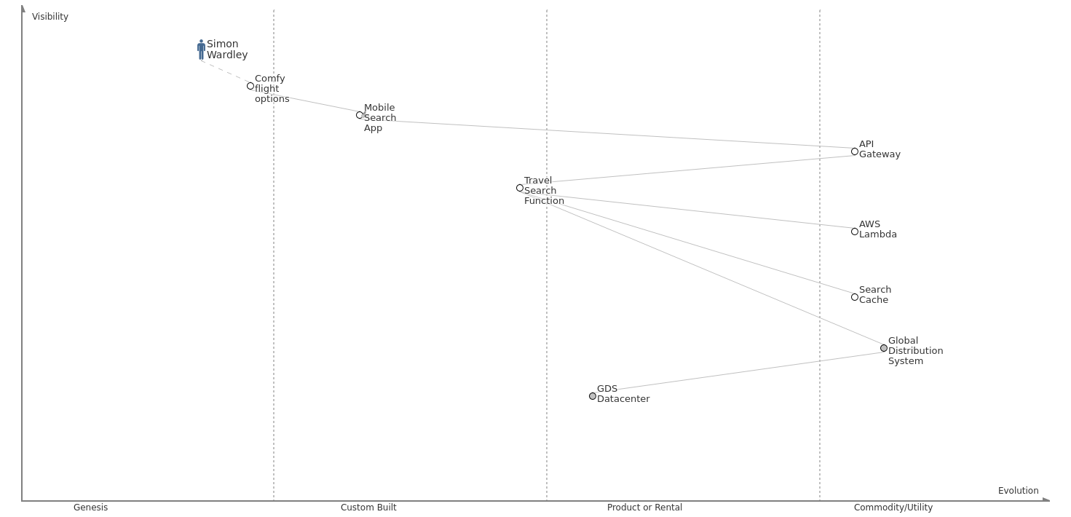
Stack evolution – serverless
Notes:
New Needs: IoT, analytics, social media monitoring, scale with number of interactions times number of products shipped, predictive modeling

Slide 43
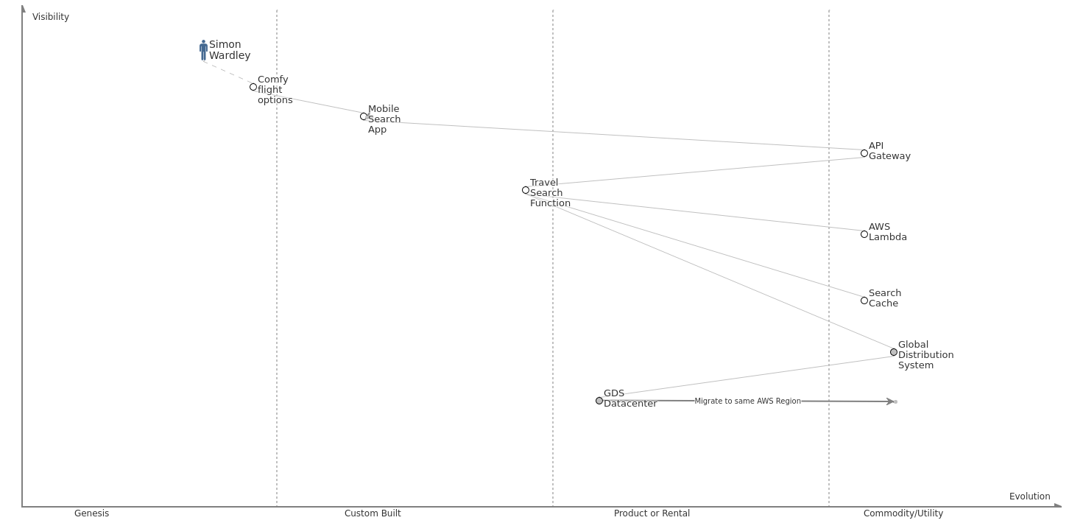
Need faster search – GDS optimized network
Notes:
New Needs: IoT, analytics, social media monitoring, scale with number of interactions times number of products shipped, predictive modeling

Slide 44
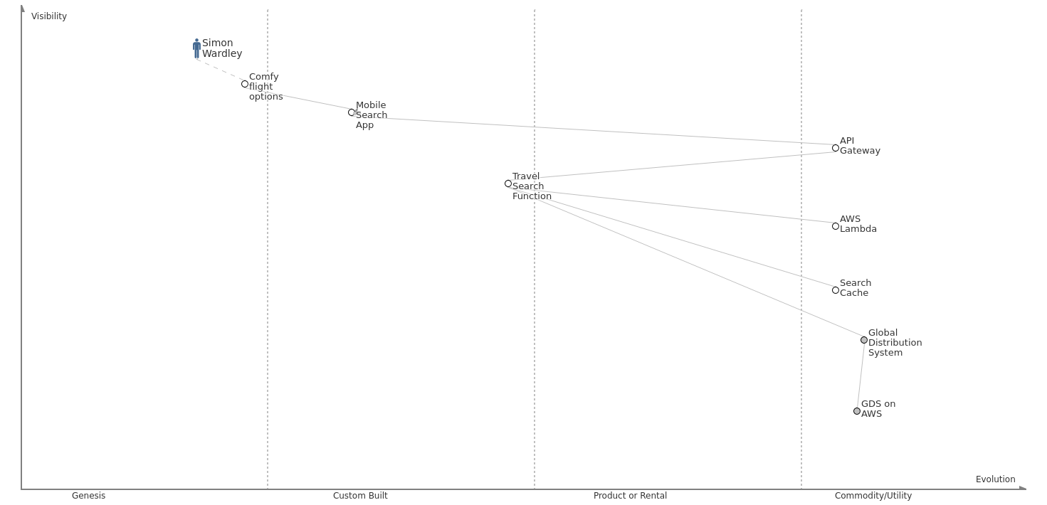
End result – happy Simon, more business value
Notes:
New Needs: IoT, analytics, social media monitoring, scale with number of interactions times number of products shipped, predictive modeling

Slide 45
Map, discuss and plan the evolution of your technology stack.
Follow @swardley and try out wardleymaps.com

Slide 46
Why should Serverless be the basis of rapid development?

Slide 47

What is the User Need?
© 2018, Amazon Web Services, Inc. or its Affiliates. All rights reserved. Amazon Confidential and Trademark

Slide 48
What is the Problem You Are Trying to Solve?
Make a model spaceship quickly and cheaply

Slide 49
Traditional
Development
Design a prototype
Carve from modelling clay

Slide 50
Traditional
Development
Carve from modelling clay
Design a prototype
Make molds

Slide 51
Traditional
Development
Make molds
Carve from modelling clay
Produce injection molded parts

Slide 52
Traditional
Development
Produce injection molded parts
Make molds
Assemble parts

Slide 53
Traditional
Development
Assemble parts
Sell finished toy
Produce injection molded parts

Slide 54
Traditional
Development
Design a prototype
Carve from modelling clay
Make molds
Produce injection molded parts
Assemble parts
Sell finished toy
Assemble parts

Slide 55
Traditional
Development
Design a prototype
Carve from modelling clay
Make molds
Produce injection molded parts
Assemble parts
Sell finished toy

Slide 56
Traditional
Development
Rapid
Big bag of blocks
Instructions
A few hours

Slide 57
Rapid
Development
Big bag of blocks
Instructions
A few hours
A finished toy

Slide 58
Rapid
Development
Lacks fine detail
Recognizable, but not exactly what was asked for
A few hours
Big bag of blocks
Instructions
Easy to modify and extend
A finished toy

Slide 59
Optimization
Take a group of Lego bricks…
…and form a new custom brick
A few hours
A more specialized common component
Big bag of blocks
Instructions
A finished toy

Slide 60
Traditional
Rapid Development
Full custom design
Months of work
Custom components may be fragile and need to be debugged and integrated
Too many detailed choices
Long decision cycles
Building bricks assembly
Hours of work
Standard reliable components scale and are well understood and interoperable
Need to adjust requirements to fit the patterns available
Constraints tend to reduce debate and speed up decisions

Slide 61
Containers
Serverless
Custom code and services
Lots of choices of frameworks and API mechanisms
Where needed, optimize serverless applications by also building services using containers to solve for
Lower startup latency
Long running compute jobs
Predictable high traffic
Serverless events and functions
Standardized choices
Combine these building blocks
AWS Lambda
API Gateway
Amazon SNS, SQS
Amazon DynamoDB
AWS Step Functions

Slide 62
Thank You
Adrian Cockcroft
@adrianco
© 2018, Amazon Web Services, Inc. or its Affiliates. All rights reserved. Amazon Confidential and Trademark

